Slide 1
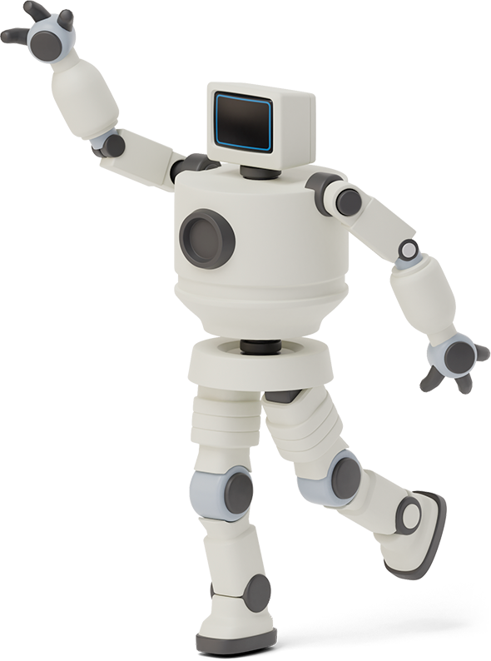

AIoT SerBot PrimeX
Presented By- Akriti Ringe
Soumyashri Singha
Dibyanshi Tripathy

Slide 2
Introduction:
Artificial Intelligence is a computer system that mimics human intellectual abilities.
With time, small AI modules were developed & various applications such as small devices and mobility devices were created.
This soon became an opportunity to incorporate AI into IoTs environment. And it made it possible to realise AIoT which is combining AI & IoT.
There are 3 cases of AI:
i) Recognition – To identify data
ii) Imitation – To imitate data
iii) Creation – To create data

Slide 3
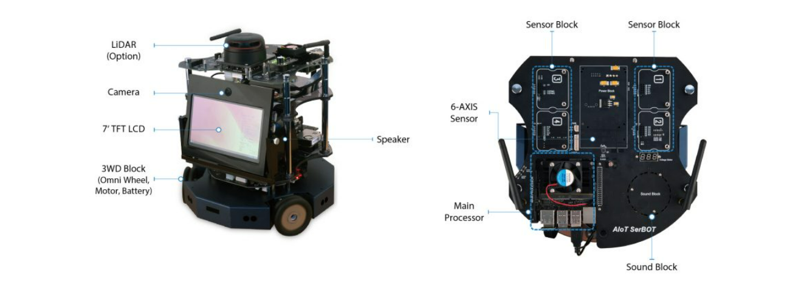
Objective:
The robot on which we are working is AIoT SerBot PrimeX which is equipped with a small AI module, Nvidia Jetson XavierNX to expect adequate AI performance.
Image classification- algorithms for object recognition to distinguish camera images.
Track driving- collecting image data to train object information required for driving.

Slide 4
IMAGE CLASSIFICATION:
Convert the images to grayscale photos.
Create a dataset of images.
Create result data for each photo.
Resize the images and put it to X_data list
Run the model specifying the number to check if giving correct output as per Y_data list
Train the CNN model using these lists.
Put the result data in Y_data list
For real-life demonstration, operate the camera and take picture
The classifier should work same as that to given dataset.

Slide 5
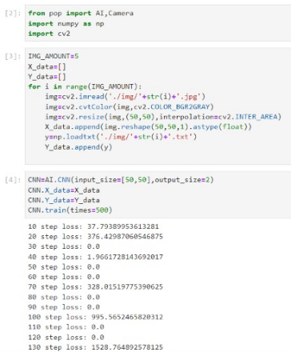
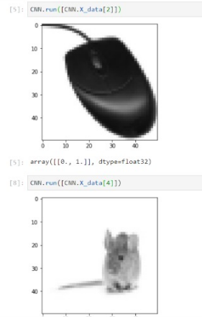
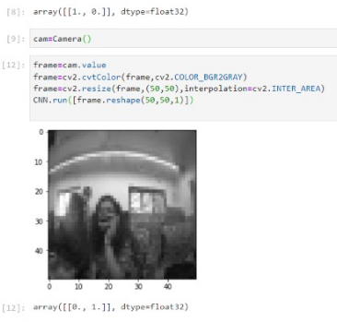
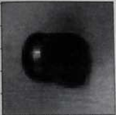

Slide 6
TRACK DRIVING:
We can either use auto-compile(time taking) or joystick method to collect images.
Create track follow class to learn tracks and load the previous dataset to it.
Using Camera class load a dataset of objects.
Store these images in Data_Collector class
We steer the vehicle forward if detects track to a certain distance.
Callback function is used to run the model and first we check by numerical result if our model is trained properly
Start training the model atleast 5 times.

Slide 7
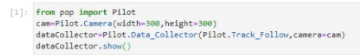
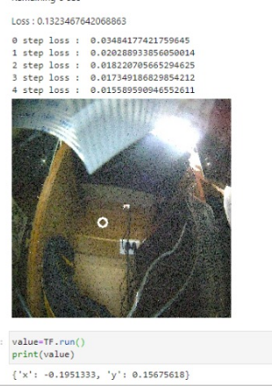
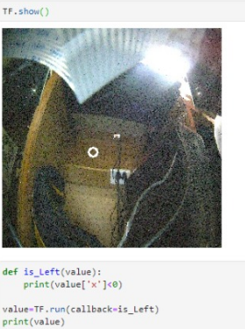
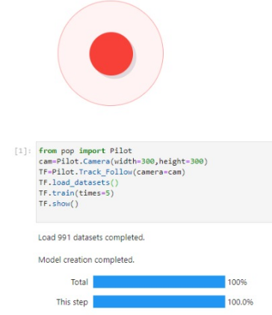

Slide 8
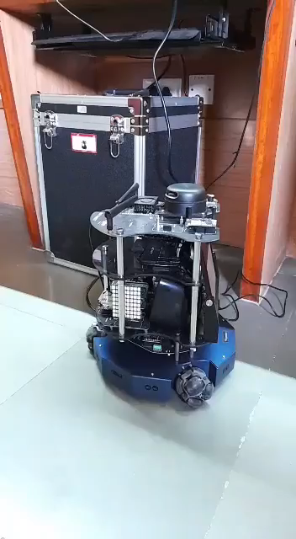
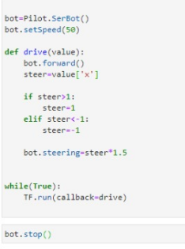

Slide 9
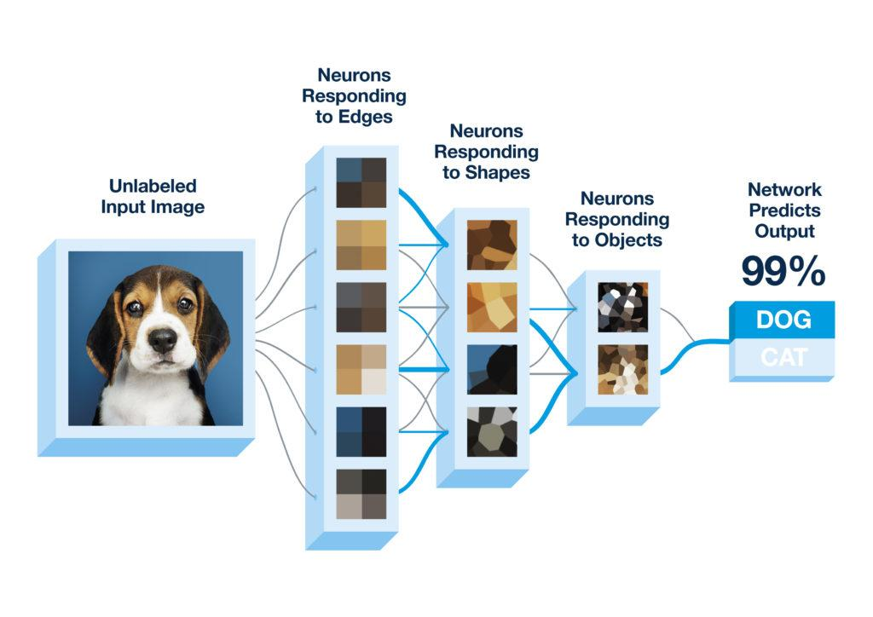
Algorithm for image classification:
CNN or convolutional neural network is being implemented here.

Slide 10
CONCLUSION
The AIoT Serbot Primex has a lot of varied applications. We’ve implemented image classification and track driving and have tested the results manually.
The vision system in robot has to be accurate so as to handle tasks at hand efficiently.The other half of the project includes tracing the track and programming the bot to govern the correct path and move accordingly.

Slide 11
FUTURE SCOPE
The AIoT SerBot acquires images in real time and detects the path.With further work,we aim to implement line tracking wherein it detects a white line drawn on the floor and follows the path. The other additions could be made by using color sensors so that it functions better.
Obstacle detection and avoidance can also be implemented in this module.

Slide 12
LINE TRACER AND OBSTACLE AVOIDANCE:
We can either use auto-compile(time taking) or joystick method to collect images.
Create track follow class to learn tracks and load the previous dataset to it.
Using Camera class load a dataset of white lines.
Store these images in Data_
Collector class
The bot stops automatically when detects an obstacle in front detected by its camera.
We steer the vehicle forward if it detects a white line path at a velocity of 40.
Start training the model atleast 5 times.

Slide 13
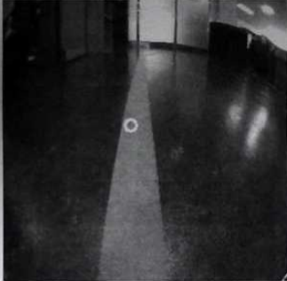
Detects white line path and moves forward
Joystick dataset collection

Slide 14
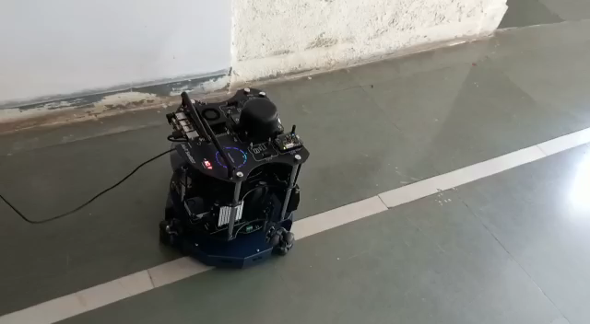
IMPLEMENTATION:

Slide 15
FUTURE SCOPE (contd.):
Further this project can be extended into cone driving and making the robot fully automated and wireless by feeding the complete codes into it.
It can also follow object detection and then decide when to stop or steer accordingly.

Slide 16
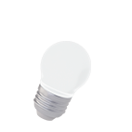
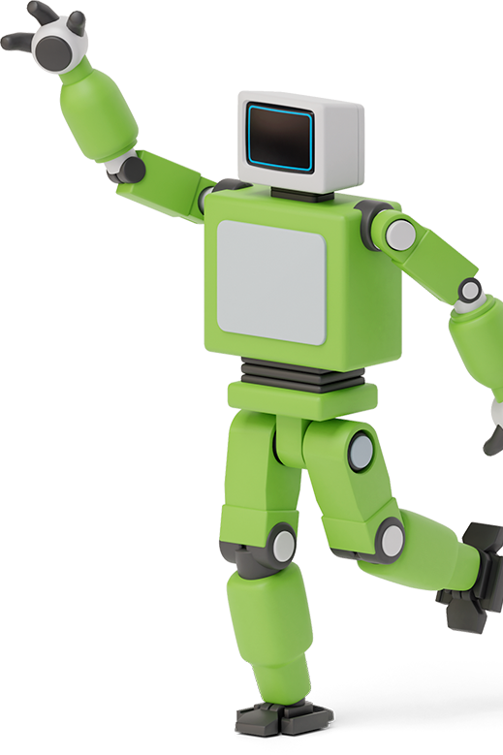

THANK YOU

